Slide 1

Amazon sales Analysis

Slide 2
Introduction
Amazon, founded by Jeff Bezos in 1994, is a global e-commerce leader headquartered in Seattle. Originally an online bookstore, it now offers a vast array of products and services, including cloud computing and digital streaming. Known for innovation and customer focus, Amazon has revolutionized online shopping and logistics. Sales management has gained importance to meet increasing competition and the need for improved methods of distribution to reduce cost and to increase profits. Sales management today is the most important function in a commercial and business enterprise.

Slide 3
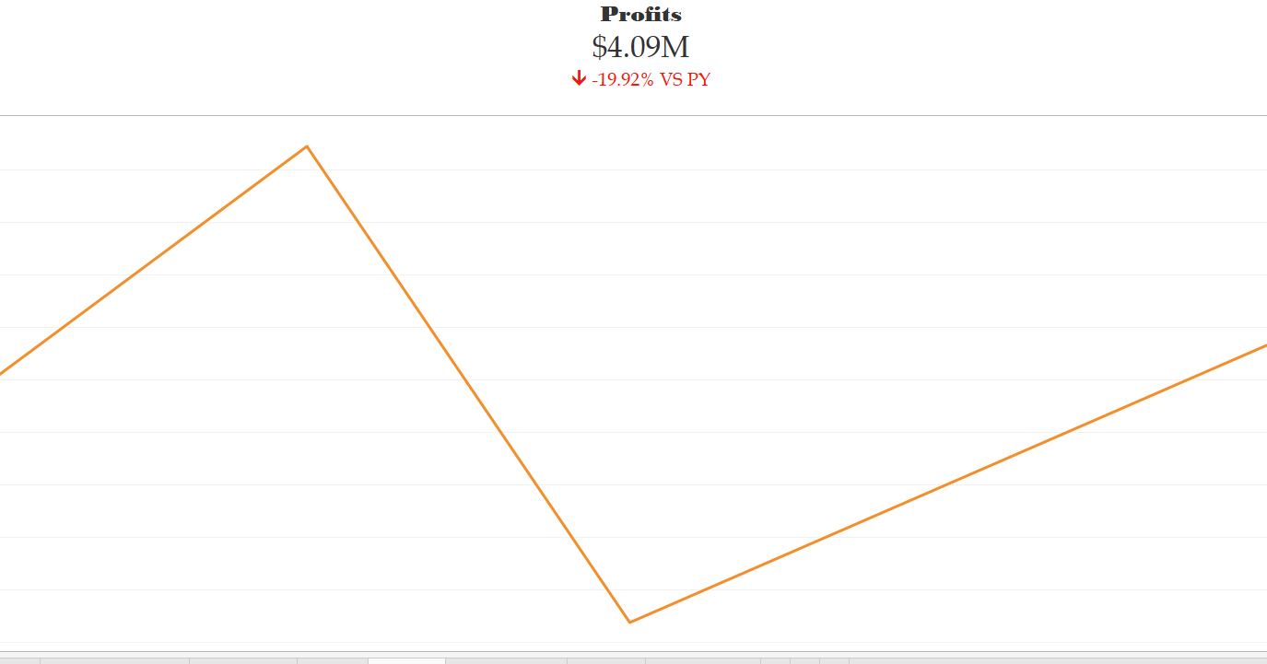
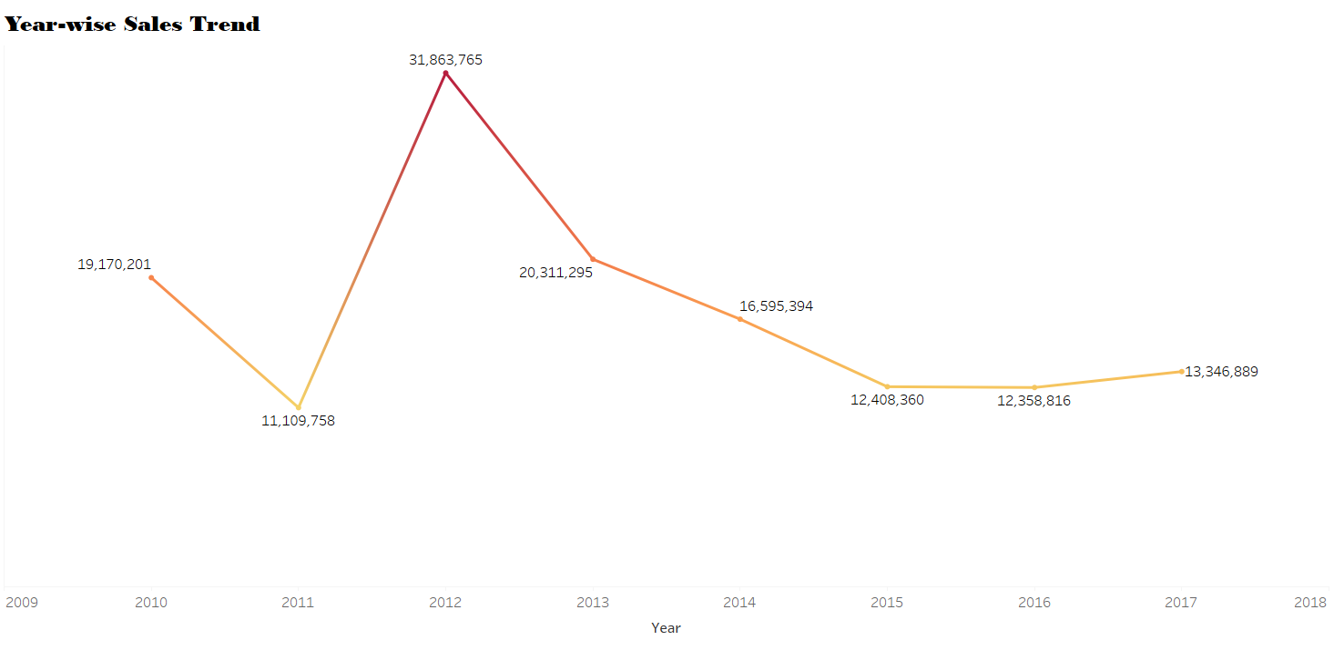
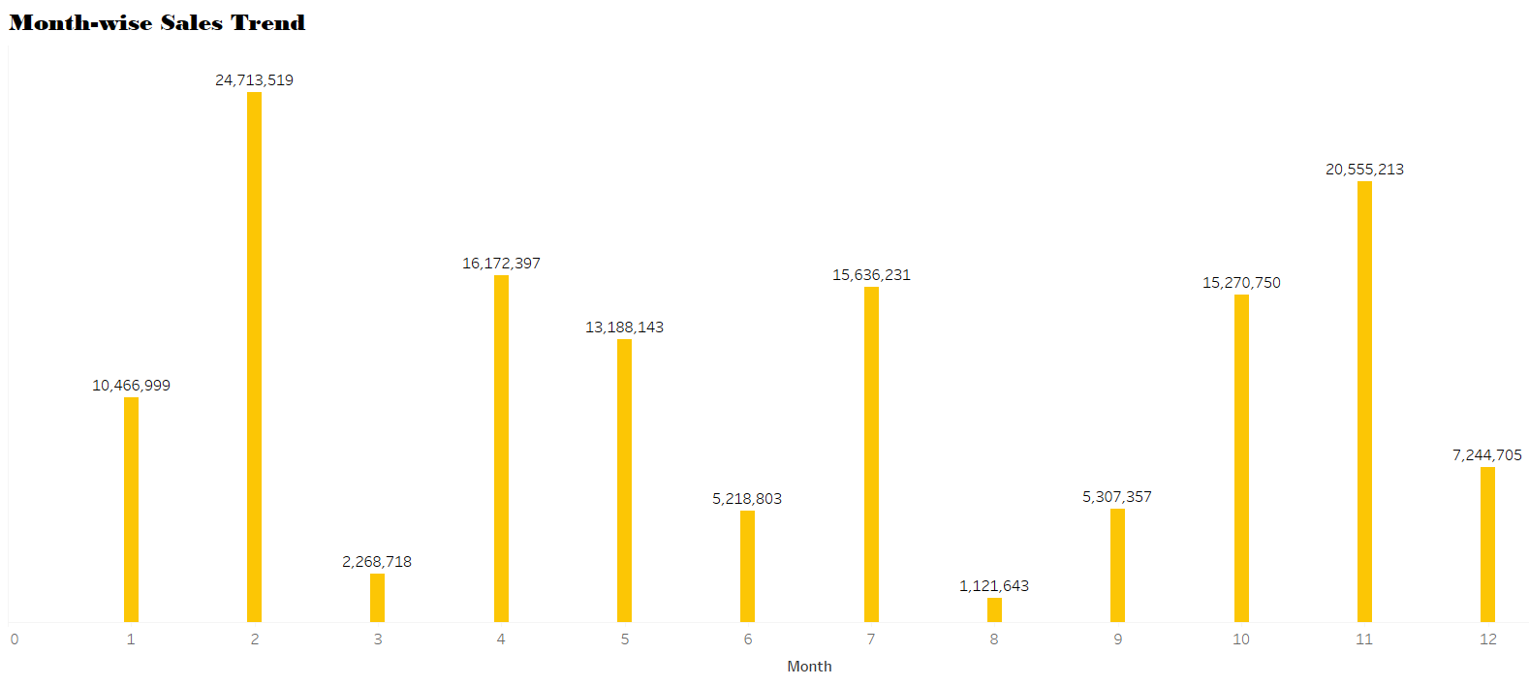
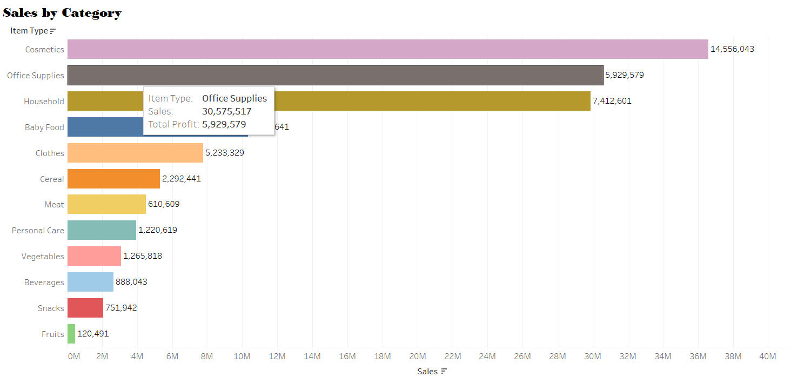
My designs

Slide 4
Main kpis
1.Sales Trend → Month-wise
Year-wise
Yearly_month-wise
2.Sales by category
3.Sales by country
4.Profits

Slide 5
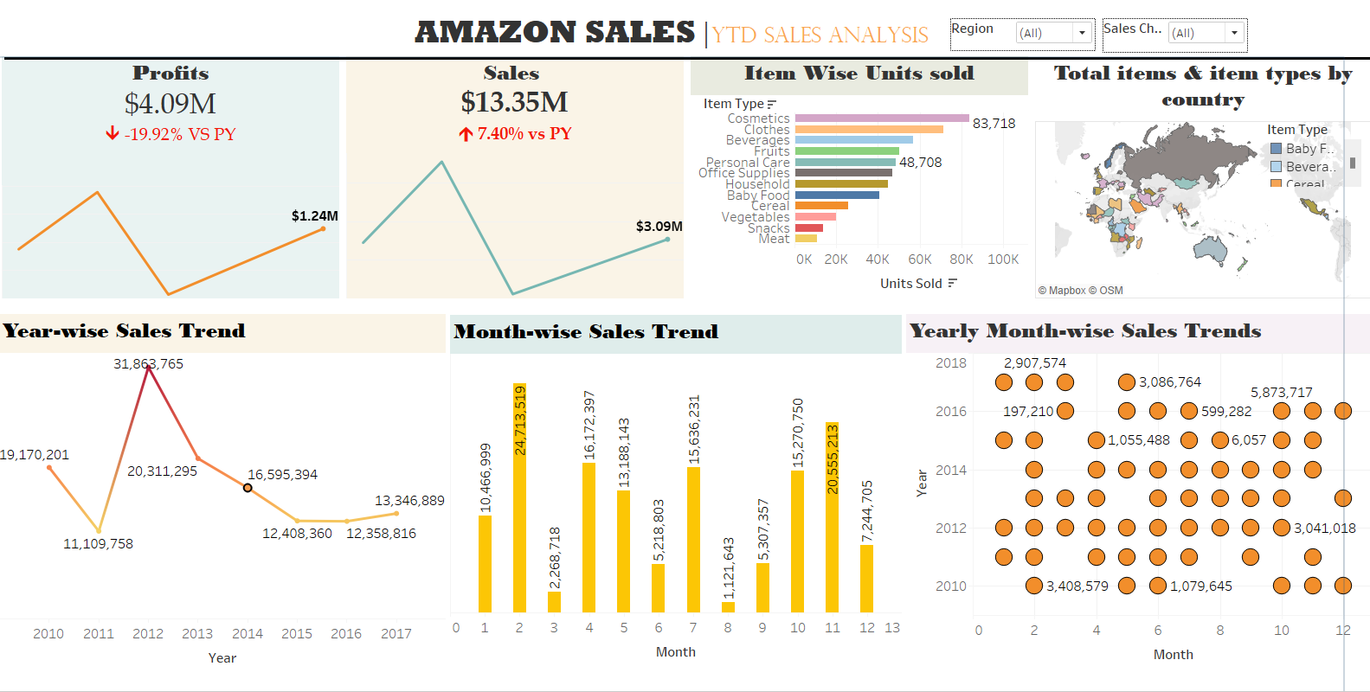
Dashboard

Slide 6
THANK YOU

